Slide 1

Air Travel is Safe
Presenter: Katie Briggs
Notes:
Be specific and direct in the title. Use the subtitle to give the specific context of the speech.
-The goal should be to capture the audience’s attention which can be done with a quote, a startling statistic, or fact. It is not necessary to include this attention getter on the slide.

Slide 2
Media tells us
Air travel is no longer safe.
Most dangerous way to travel.
Driving up the fear of traveling by airline.
What does the data tell us?

Slide 3
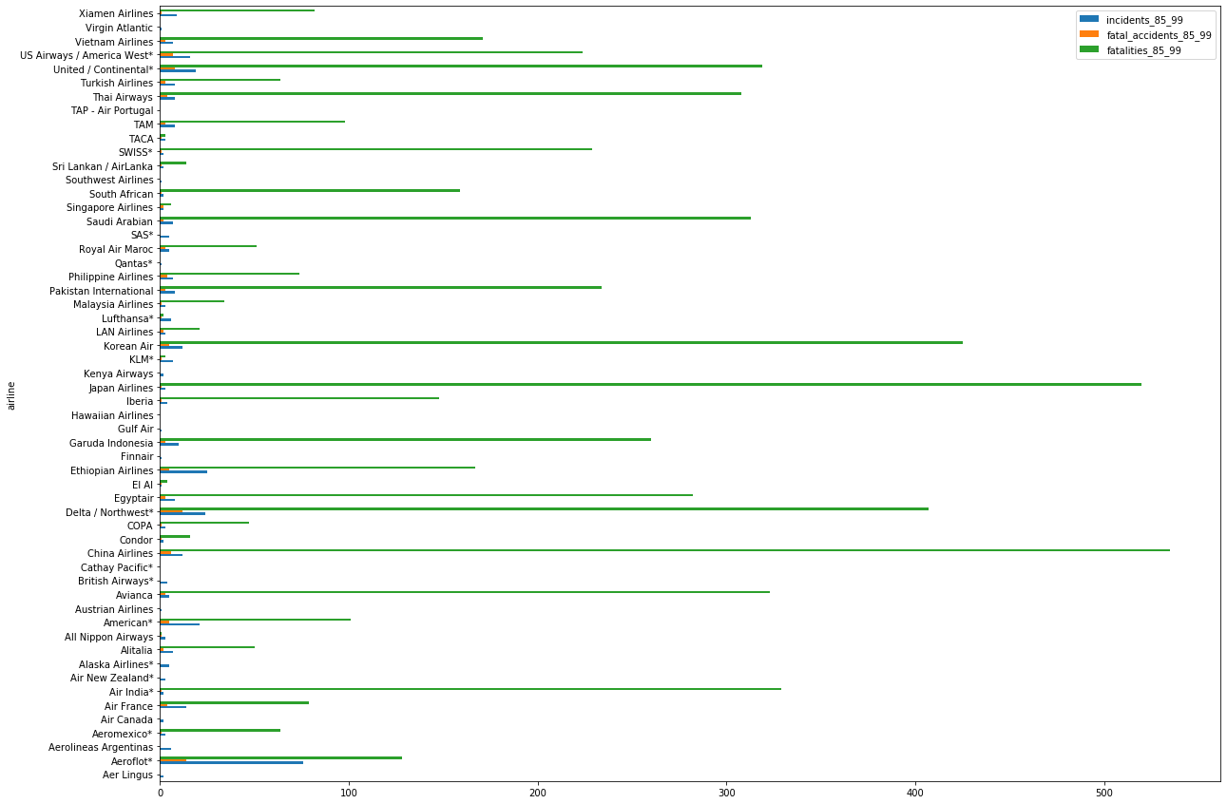
Air Travel is Safe Compared to 35 Years Ago
As seen in the first plot from 1985 to 1999, airline incidents and fatalities had a higher probability to occur.
Notes:
Use the background points to post details that are not common knowledge, or that the audience will need to understand the context of the speech.
-Do not read these main points from the PowerPoint, instead elaborate on these points during the speech.

Slide 4
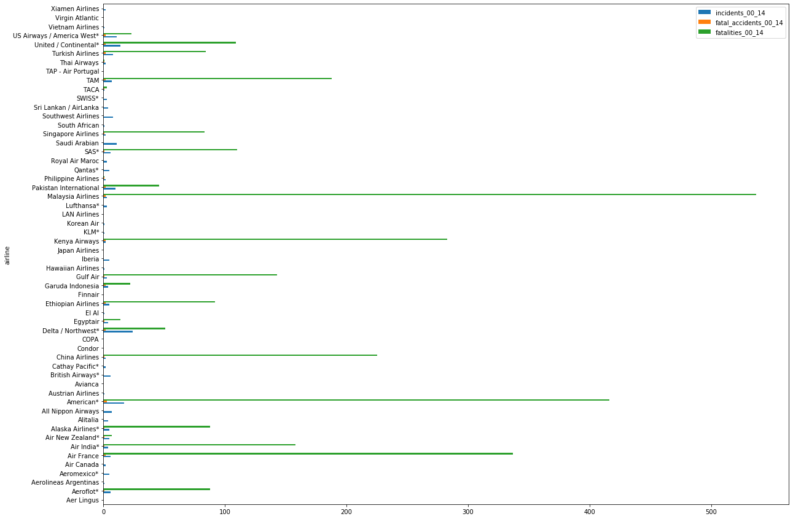
Air Travel is Safe Compared to 35 Years Ago
Due to increased safety regulations and technology, incidents and fatalities have reduced. We see that here with year 2000 to 2014.
Notes:
Use the background points to post details that are not common knowledge, or that the audience will need to understand the context of the speech.
-Do not read these main points from the PowerPoint, instead elaborate on these points during the speech.

Slide 5
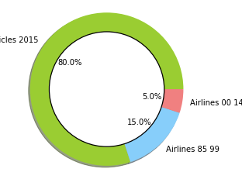

Air Travel is Safe Compared to Vehicles
According to department of transportation 10,000 people passed away in the year 2015 while traveling in a vehicle.
In Airlines from 1989 to 1999 there were 6,288 fatalities.
In Airlines from 2000 to 2014 there were 3,020 fatalities.
Notes:
The title of main point #1 should be clear and concise. Each piece of evidence should be summarized for clarity and cited correctly. Do not simply read the pieces of evidence, but elaborate where needed.
[type notes for elaboration here]
Be sure to transition to main point #2 and the next slide.

Slide 6
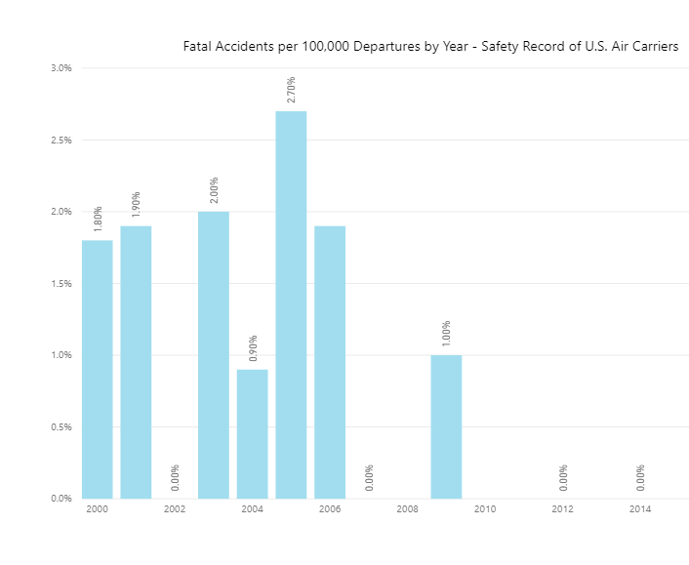
Air Travel is Safer than Ever
According to Aviation Safety Network there are less than 3% of fatalities per 100,000 departures.

Slide 7
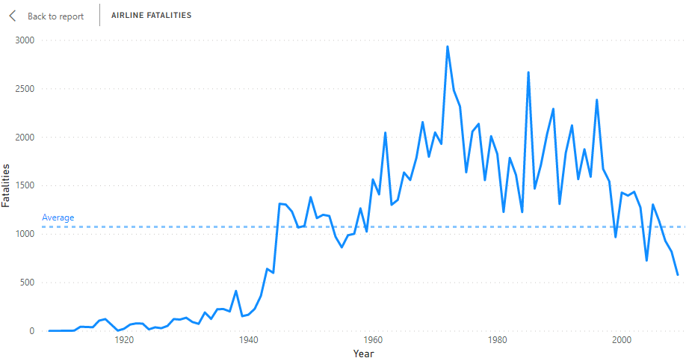
Air Travel is Safer Overtime
Timeline of Airline Fatalities:
By 2009 fatalities were down by 24.48%.
Notes:
The title of main point #2 should be clear and concise. Each piece of evidence should be summarized for clarity and cited correctly. Do not simply read the pieces of evidence, but elaborate where needed.
[type notes for elaboration here]
Be sure to transition to main point #3 and the next slide.

Slide 8
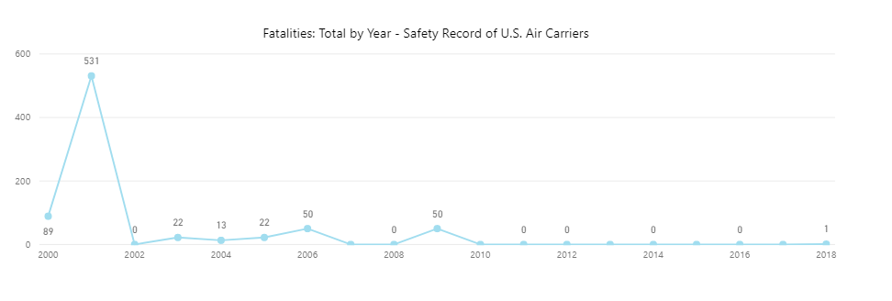
Air Travel is Safer Overtime
Timeline of Airline Fatalities:
Currently averaging 1 fatality a year since 2018.
Notes:
The title of main point #2 should be clear and concise. Each piece of evidence should be summarized for clarity and cited correctly. Do not simply read the pieces of evidence, but elaborate where needed.
[type notes for elaboration here]
Be sure to transition to main point #3 and the next slide.

Slide 9
References:
Airline Safety. (2018). Retrieved from https://github.com/fivethirtyeight/data/tree/master/airline-safety Airplane Crashes Since 1908. (2016). Retrieved from https://www.kaggle.com/saurograndi/airplane-crashes-since-1908/version/4#Airplane_Crashes_and_Fatalities_Since_1908.csv Bomey, N. (2018). U.S. Vehicle Deaths Topped 40,000 in 2017, National Safety Council Estimates. Retrieved May 3, 2020, from https://www.usatoday.com/story/money/cars/2018/02/15/national-safety-council-traffic-deaths/340012002/ Rolph, C. (2019). The Safety of Airlines. Retrieved from https://blog.stafftraveler.com/aviation/airline-safety/ Schaper, D. (2020). Boeing 737 Max May Stay Grounded into Summer. Retrieved, from https://www.npr.org/2020/01/21/798312515/boeing-737-max-may-stay-grounded-into-summer Shepardson, D. (2018). 2017 Safest Year on Record for Commercial Passenger Air Travel. Retrieved from https://www.reuters.com/article/us-aviation-safety/2017-safest-year-on-record-for-commercial-passenger-air-travel-groups-idUSKBN1EQ17L System Total Operating Revenue. (n.d.). Retrieved from http://web.mit.edu/airlinedata/www/Revenue&Related.html

